Slide 1
Project Retrospective:
Cardiology Patient Management System
SPP400: Greg Malicki, Kyle Levy, Kyle Dorcey, Evan Meyer, Alex Michel

Slide 2









Technology Platforms
Application:
Django Python web framework
Bootstrap front end styling
Chart.JS for graphical analytics
Testing:
Integrated python unit testing
Travis CI for automated unit testing and coverage report generation
Selenium and PhantomJS for BDD
Deployment:
Compatible with AWS Elastic Beanstalk, with HIPAA compliant servers available

Slide 3
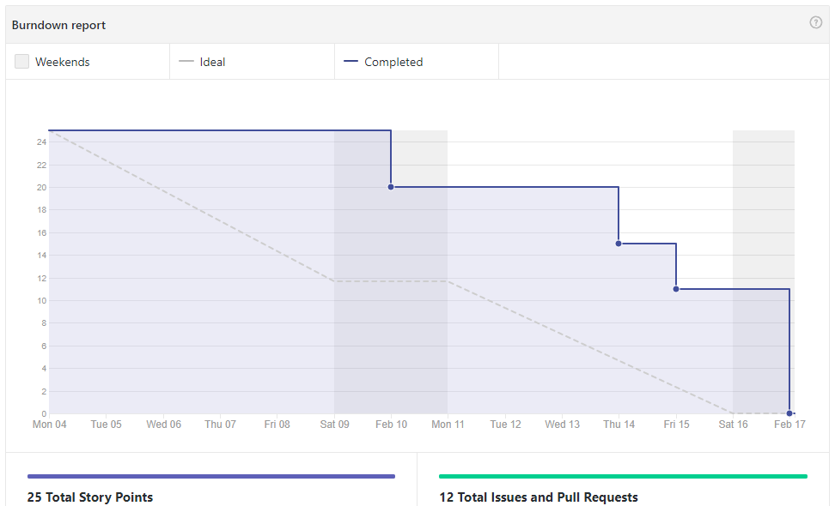
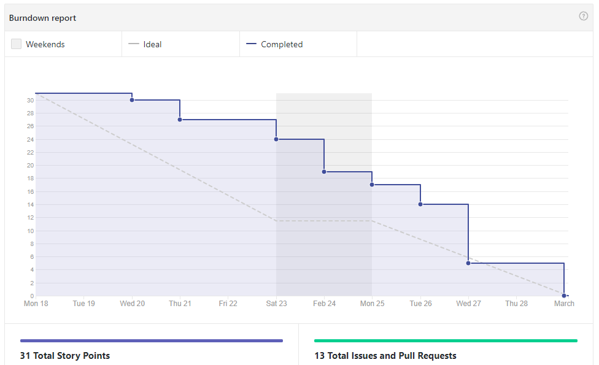
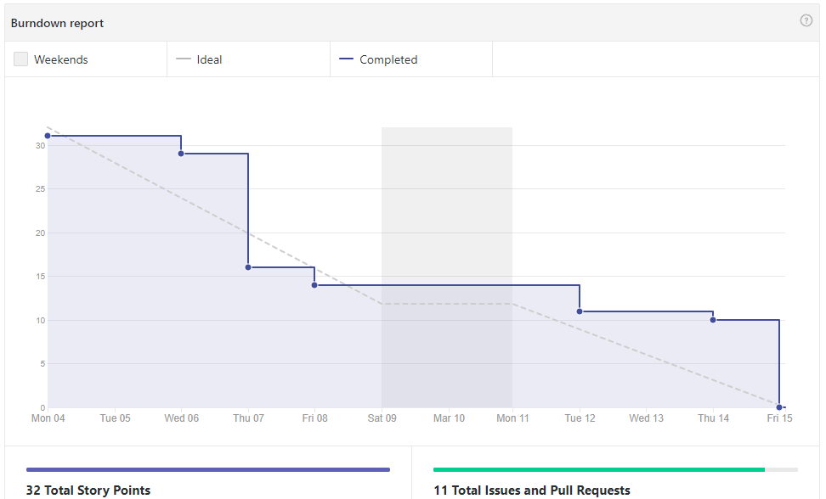
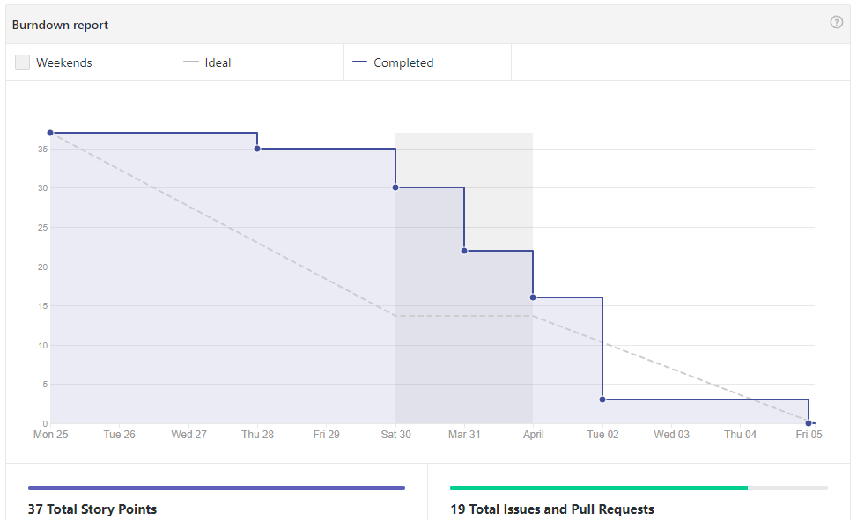
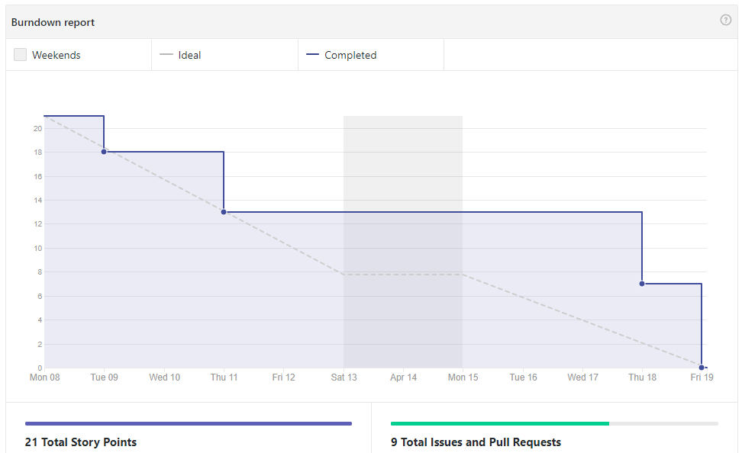
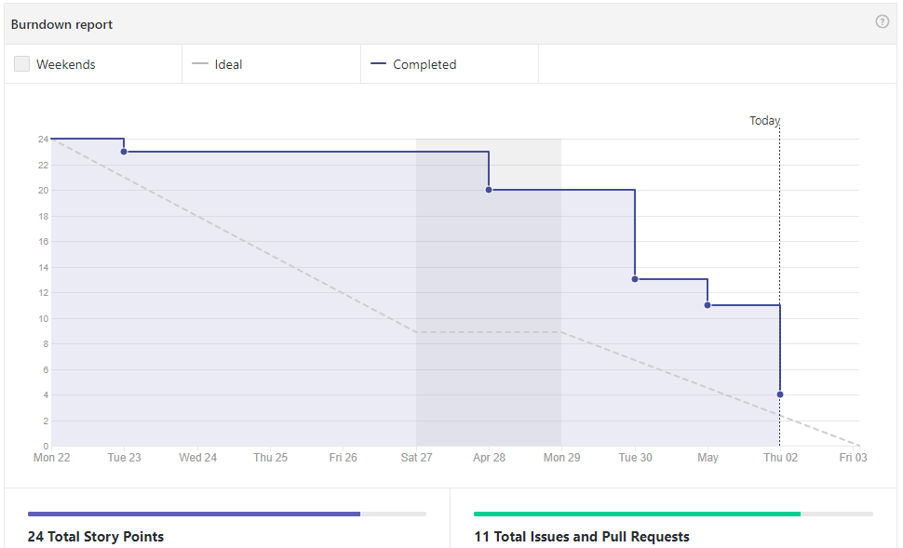
Burndown Progression
Issues Changed: 3
Issues Added: 3
Issues Changed: 1

Slide 4
Process Weaknesses
Project requirements were loosely defined
More of a concrete goal and plan needed for product owner meetings
Sprint planning process was never fully developed
Never put an issue creation template in place
Inconsistency made planning less effective
Pull request approvals became slower over time
We aimed to have 24 hour maximum pull request but ended up closer to 36-48 hours

Slide 5
Process Strengths
Effective team communication
Daily weekday SCRUM meetings kept all team members informed
Discord allows for separating chat channels for effective record keeping, and less confusion
Story points were effectively assigned
Minimal need to change-log the sprint backlog, changes were mostly for clarification
Most often issues were broken down in a way that caused minimal dependencies, allowing for greater parallel work capacity

Slide 6
Lessons Learned
Requirement gathering is both very important and very difficult
We need to rigorously structure our limited time with our product owner
Poor requirement gathering leads to a highly difficult development process, and an end product that does not live up to its full potential
Team communication greatly increases velocity
Avoid repeating work and re-solving the same problems
Good planning and issue defining leads to good solutions
Poorly planned issues produce less measurable progress
Poorly planned sprints lead to significantly less productive development time
Always have and follow guidelines for sprint planning

Slide 7
Shortcomings and Future Work
Improved site performance is needed
Our most data intensive pages can be slow to load
Relationships can be difficult to work with and understand
Database should be reworked to be more intuitive for development and more efficient to query
Further analytics needed
Only the analytics requested by Dr. Horwitz have been implemented
Existing analytics displays need improvement to reach their peak usefulness
More advanced and customizable data analysis can be added to increase impact

Slide 8
Demonstration

